Slide 1
Deep Learning
Optimizers

Slide 2
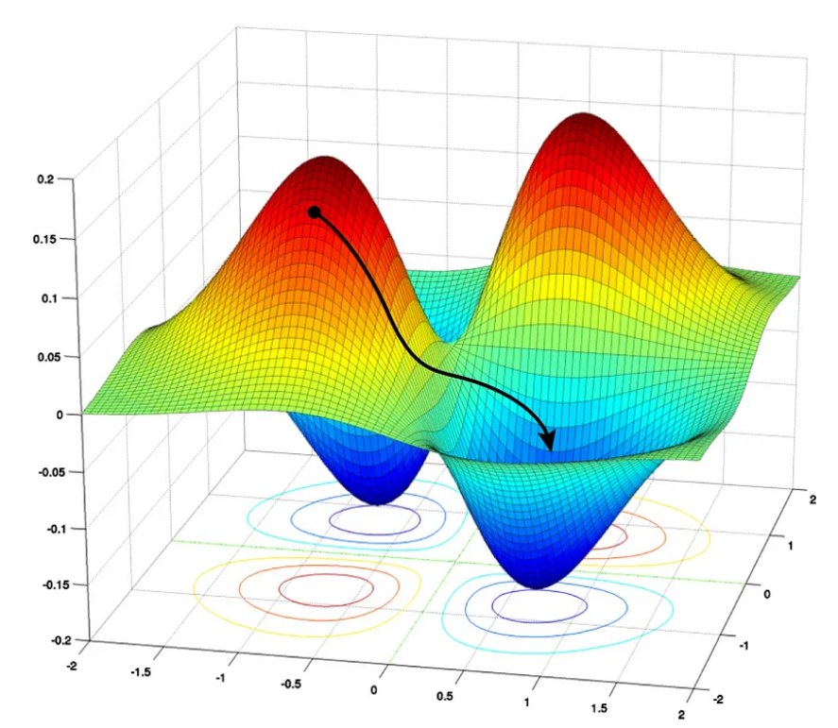

Slide 3
Optimizers
Optimizers are algorithms used to find the optimal set of parameters for a model during the training process.
These algorithms adjust the weights and biases in the model iteratively until they converge on a minimum loss value.

Slide 4
Types Of Optimizers
Gradient Descent Algorithm
Stochastic Gradient Descent
Mini-batch Gradient Descent
Momentum
Nesterov
Adagrad
RmsProp
Adam

Slide 5
Optimization Challenges in Deep Learning
Learning Rate
Learning Rate Scheduling
Multiple optimal value find
Local Minima
Saddle Point

Slide 6
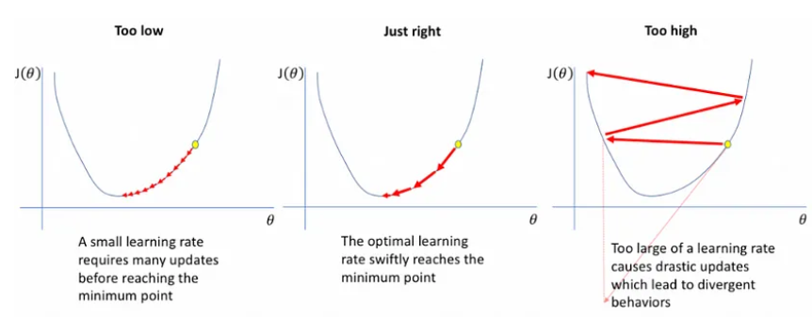
Learning Rate
Our goal is to find the right learning rate which will get us to the optimum in the right amount of steps.
Luckily we have many libraries/ frameworks which help in selecting the best hyperparameters like optuna, hyperopt, gridsearchcv, Ray-Tune, keras_tuner and many more.

Slide 7
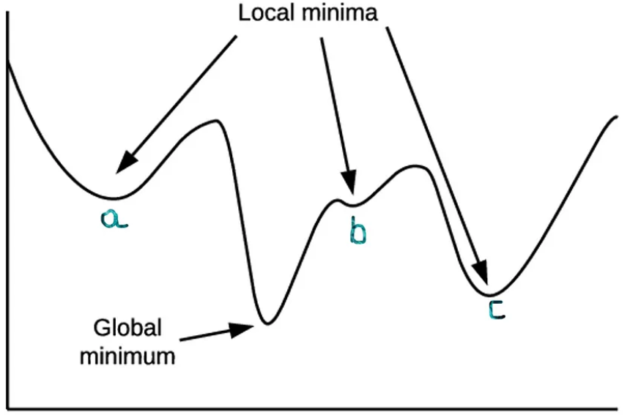
Local Optima

Slide 8
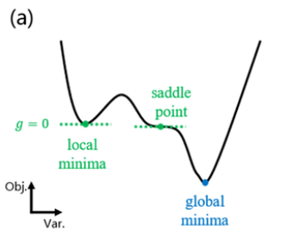
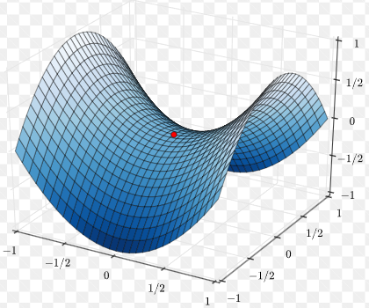
Saddle point
A point on the surface of the graph of a function where the slopes (derivatives) in orthogonal directions are all zero (a critical point), but which is not a local extremum of the function

Slide 9
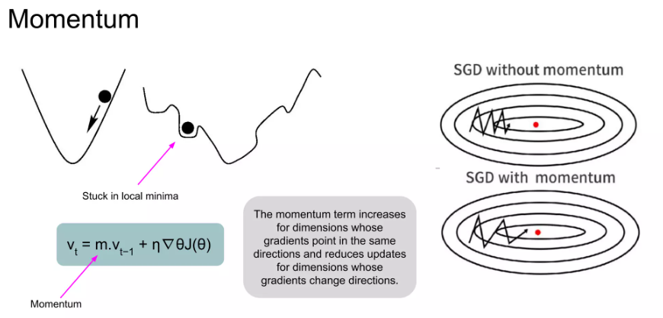
Momentum
Momentum simulates the inertia of an object when it is moving, that is, the direction of the previous update is retained to a certain extent during the update, while the current update gradient is used to fine-tune the final update direction.

Slide 10
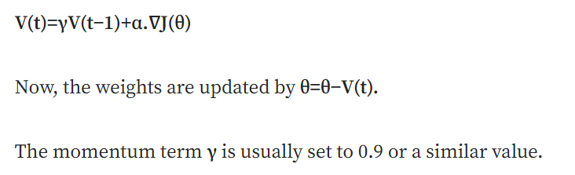

Slide 11
Advantages of SGD with momentum
Momentum helps to reduce the noise.
Reduces the oscillations and high variance of the parameters.
Exponential Weighted Average is used to smoothen the curve.
Converges faster than gradient descent.
Disadvantage of SGD with momentum
Extra hyperparameter is added.

Slide 12
Nesterov Accelerated Gradient (NAG)
Momentum may be a good method, but if the momentum is too high the algorithm may miss the local minima and may continue to rise up. So, to resolve this issue the NAG algorithm was developed

Slide 13
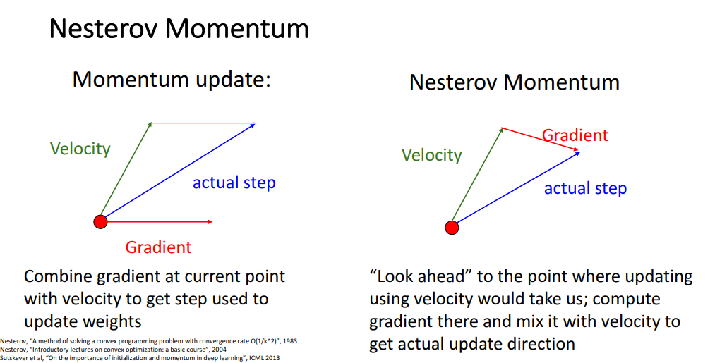

Slide 14
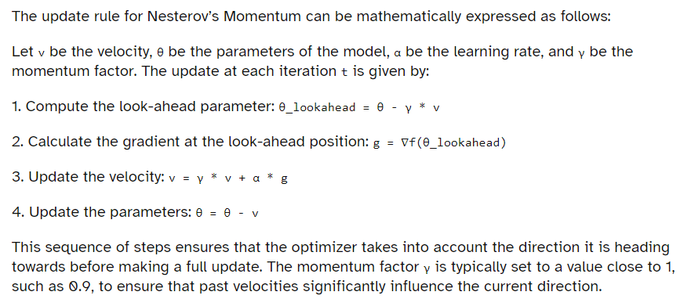

Slide 15
Advantages of Nesterov’s Momentum
Speed: It converges faster to the minimum, especially in scenarios where the surface of the loss function has many flat regions or sharp curvatures.
Responsiveness: The look-ahead step allows the optimizer to be more responsive to changes in the gradient, which can help in avoiding suboptimal local minima.
Stability: It tends to overshoot less and exhibits more stable convergence behavior.
When to Use Nesterov’s Momentum
Nesterov’s Momentum is particularly useful when training deep neural networks with complex loss landscapes. It is well-suited for tasks where the optimization path may contain many saddle points or regions with high curvature. However, it is important to tune the hyperparameters, such as the learning rate and momentum factor, to achieve the best performance.

Slide 16
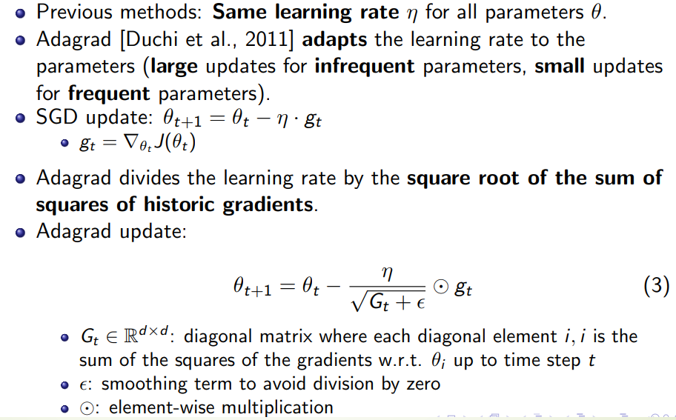
AdaGrad (Adaptive Gradient)

Slide 17
Advantage
Well-suited for dealing with sparse data.
Significantly improves robustness of SGD.
Lesser need to manually tune the learning rate.
Disadvantage
Accumulates squared gradients in the denominator.
This causes the learning rate to shrink and become infinitely small.

Slide 18
RMS prop
https://deepai.org/machine-learning-glossary-and-terms/rmsprop

Slide 19
Adam
https://builtin.com/machine-learning/adam-optimization#:~:text=Adam%20is%20an%20adaptive%20learning,A%20Method%20for%20Stochastic%20Optimization.%E2%80%9D&text=Image%3A%20Screenshot%20by%20the%20author.

Slide 20
Reference
https://towardsdatascience.com/understanding-deep-learning-optimizers-momentum-adagrad-rmsprop-adam-e311e377e9c2
https://medium.com/game-of-bits/understanding-optimizers-for-training-deep-learning-models-694c071b5b70

Slide 21
Regularization methods:
Add constraints or penalties to the loss function or parameters to prevent overfitting and improve generalization.
Examples are L1 and L2 regularization, dropout, batch normalization, and data augmentation
Hyperparameter tuning
Optimize hyperparameters of the model and optimization algorithm such as learning rate, batch size, number of layers, number of neurons, and activation functions.
Hyperparameter tuning methods can improve the performance and efficiency of the model and optimization algorithm by finding the best combination of hyperparameters for a given problem.
Examples are grid search, random search, Bayesian optimization, and evolutionary algorithms

